Slide 1
Acceptance Test Front
Framework playwright
PLAN DE FORMACIÓN - 2023

Slide 2
Warmup
Core commands
Structure and example build

Slide 3
What is Playwright?
Playwright is a Node.js library developed by Microsoft to automate web application flows in Chromium, Firefox, and WebKit reliably and quickly.
Playwright is designed to automate Single Page Apps (SPA) and Progressive Web Apps that use all the capabilities that a browser currently offers.

Slide 4
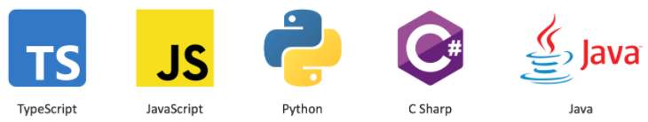
Some features are:
Multi-page scenarios.
Auto-waiting of DOM elements until they are ready to interact with them as click, type.
Emulate mobile devices, geolocation, and permissions.
Compatible with the following languages:

Slide 5
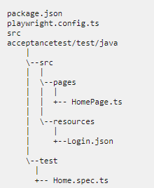
Folder structure and packages
Config reports, times and retries
Define pages or similar/general actions
Use documents or other resource elements
Scenarios and test scripts

Slide 6
Core commands
Initialize playwright core
npm init –y
clear cache
npm cache clean –force
install dependencies
npm i -D playwright @playwright/testRun
install node modules
npm install
the codegen to our url
npx playwright codegen https://discuss.apps.bancolombia.com/
npx playwright codegen --save-storage=auth.js
run tests
npx playwright test
To show in a browser we add:
--headed
Run in all browsers
npx playwright test --browser=all

Slide 7
Questions?

Slide 8
Thanks a lot.

